Slide 1
LAR3 AMP
Definition Phase
Project Team
Project Lead: Scott McConnell
Project Sponsor: Jay Imbery
ATL: Area 1, Area 2, Area 3, Area 5, Area 7, Area 9
Technical Support: Scott Flanagan, Michael Kelsheimer, Robby Jackson, Ethan Spielvogel, John White

Slide 2
LAR3 AMP
End of Definition
WHY: Project Justification
The primary drivers for this project are regulatory compliance to close LOPA and RSP gaps and mitigating obsolescence. Technical obsolescence of the BPCS and PLCs as well as compliance gaps in fired heaters and rotating equipment present safety, maintenance, and sustainability risks to the refinery.
Background Information
In January 2018, AMP completed the Conceptual Phase for the entire program, which included the legacy Andeavor LAR sites. The TIC Estimate at the time was factored using a Wood estimate tool and historical benchmarks on previous automation projects.
LAR Modernization and Blending Modernization were identified as separate projects during the Conceptual Phase and progressed independently through Feasibility and Definition.
For LAR Modernization, Wood completed the Feasibility Phase for LAR2 through LAR9 on a program basis. In June of 2021, LAR2 through LAR9 was transferred to LAR and Feasibility Phase for LAR3 was awarded to Mangan.

Slide 3
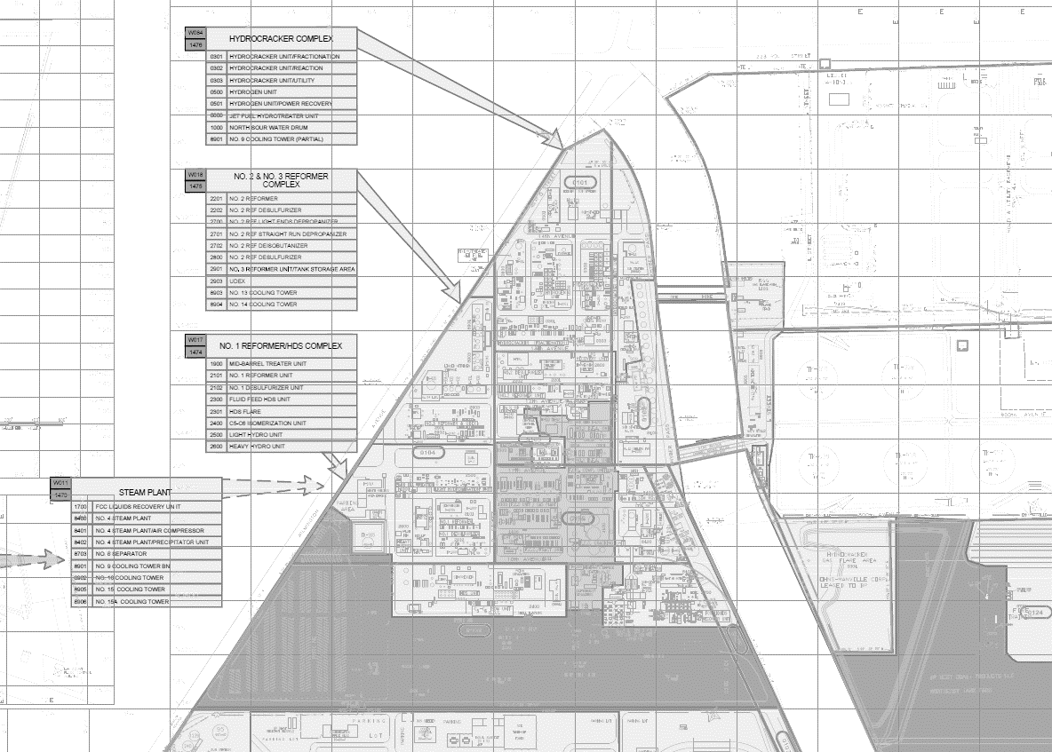
LAR3 AMP - Scope
Project Plot Plan
LAR3 AMP | Definition
LAR-C North Area
Area 1 | 1Reformer TAR = Oct ‘25
#1 Ref Htr
SPLC (N)
Area 2 | FCC
TAR = Oct ‘25
#1 Desulf Htr
SPLC (N)
#1 Ref Recyl
UCP (N)
Born Feed Htr
SPLC (E)
#1 Desulf Recyl
Pignone Compr
1Ref/Desulf Feed
Equipment Legend
1Ref/Desulf Spare
(N) = New
(E) = Existing, Tie-In
(M) = Existing, Modify/Upgrade
(C) = Cutover/Migrate
Area 1 |FFHDS / LHU
TAR = Oct ‘25
FFHDS Rx Htr
SPLC (E)
BPCS Console / Network
FFHDS Prism
BPCS DCS Controllers
LHU Feed Htr
SPLC (E)
BPCS GP PLC
SPLC / UCP
Heater / Boiler
RTE-R
RTE-C

Slide 4
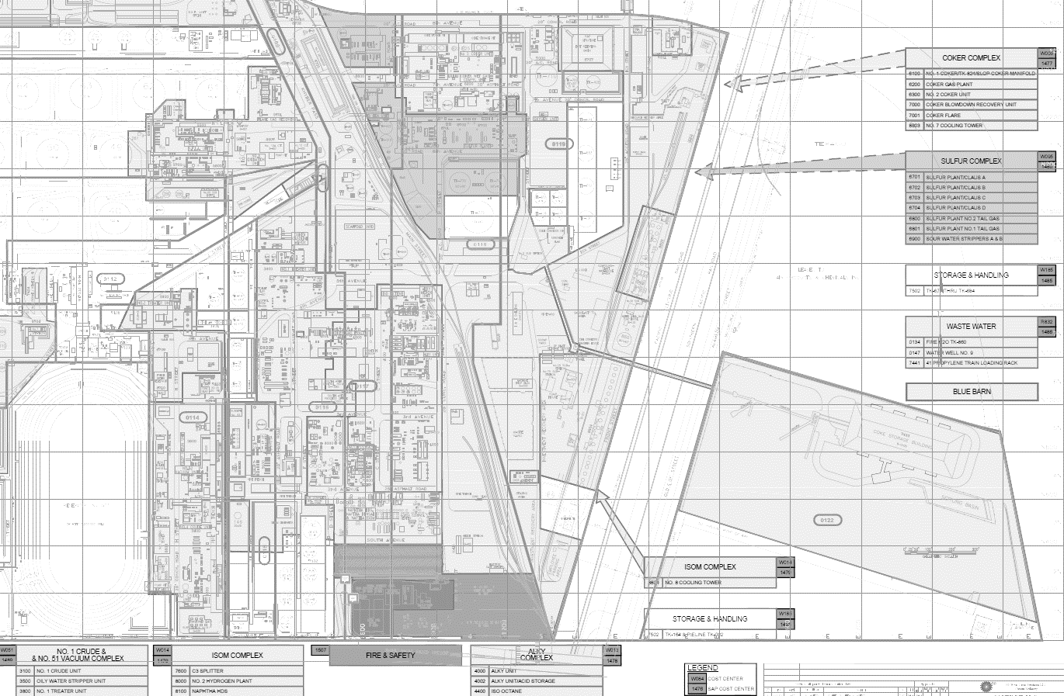
LAR3 AMP - Scope
Project Plot Plan
LAR3 AMP | Definition
LAR-C South Area
Area 9 | Sulfur Plant
Area 3 | 1Crude/51Vac
BPCS Console / Network (SACCR)
BPCS Console / Network (SACCR)
TRS Process Analyzer (C)
SRU Unit Alarm (C)
SA CEMS Data Cont. PLCs (C)
Sulfur Loading Rack (C)
1 Crude Unit Alarm (C)
Area 5 | Alky
TAR= Oct ‘25
Equipment Legend
(N) = New
(E) = Existing, Tie-In
(M) = Existing, Modify/Upgrade
(C) = Cutover/Migrate
BPCS Console / Network (N)
LCR4: TDC2000 → Experion (N)
LCR6: TDC2000 → Experion (N)
BPCS Console / Network
Alky/Merox Unit Alarms (M)
BPCS DCS Controllers
Alky Air Dryer (C)
BPCS GP PLC
Butamer Air Dryer (C)
SPLC / UCP
Area 5 | SACCR/LCR-7
Alky Refrig. Compr. CCC (C)
Heater / Boiler
Virtualization Server / UPS
Area 5 | NHDS
TAR = Jan ‘26
Alky Refrig. Compr.
RTE-R
Fiber Optic Infrastructure
RTE-C
Rx Feed Htr
SPLC (E)

Slide 5
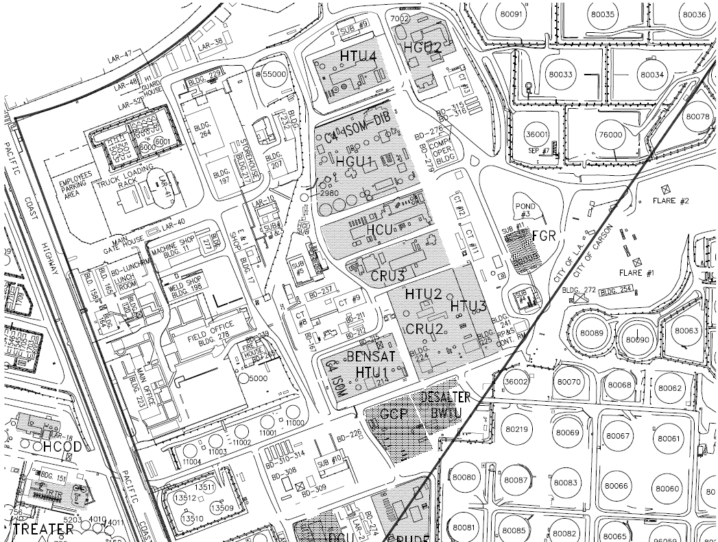
LAR3 AMP - Scope
Project Plot Plan
LAR3 AMP | Definition
LAR-W North Area
Area 7 |
HPD Rackroom
Area 7 | WHCU
TAR = Oct ‘26
H-300
SPLC (M)
H-301
Area 7 | HGU1/2
TAR = Jun ‘25
H-302
H-303
C-84
SPLC (M)
H-304
C-146
C-93
C-147
C-148
H-42 Refrm Htr
SPLC (N)
H-43 Aux Blr
SPLC (N)
Equipment Legend
(N) = New
(E) = Existing, Tie-In
(M) = Existing, Modify/Upgrade
(C) = Cutover/Migrate
NACR
BPCS Console / Network
BPCS DCS Controllers
BPCS GP PLC
SPLC / UCP
Heater / Boiler
RTE-R
RTE-C

Slide 6
BACKUP
CONFIDENTIAL
6

Slide 7

LAR3 AMP - Scope
Area 1, 1 Reformer Heater LOPA & RSP Gaps – HR: Carson
RED = New
BLACK = Existing
Equipment
#1 Reformer Heater (RW-0025)
#1 Reformer Desulfurizer Heater (RW-0026)
As Found
No existing automated shutdown system or SIFs
New Scope
Applies to both heaters (RW-0025 & RW-0026)
2 new fuel gas chopper valves with bypass and ASCO RCS
2 new pilot gas chopper valves
2 new SIS fuel gas pressure XMTRs per cell, downstream of existing FG control valve
1 new dedicated pilot gas regulator with new SIS pilot gas pressure XMTR downstream
1 new light-off panel (LOP)
3 new manual ESDs – console, remote (>50ft from heater), local (LOP)
1 new SIS flow XMTR on existing BFW, steam, and naphtha flow orifices for low flow trips
Add interlock for O₂ analyzer probe heater power de-energization on full heater trip
Piping modifications on recycle compressor discharge to install new flow meter to directly measure recycle gas flow to heater passes for low flow heater trip
1 new Tricon CX SIS will be installed in #1 Reformer Rack Room as common logic solver for both heaters (RW-0025 & RW-0026) HR: Modbus map to be added as appendix to the FDS

Slide 8
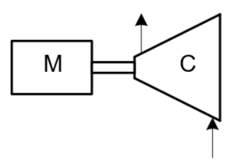
LAR3 AMP - Scope
Area 1, 1 Reformer Compressor LOPA & RSP Gaps HR: Carson
RED = New
BLACK = Existing
Equipment
#1 Reformer Recycle (RW-0004)
#1 Desulfurizer Recycle (RW-0022)
#1 Desulfurizer Feed Gas (RW-0005)
#1 Desulfurizer Common Spare (RW-0006)
As Found
No existing KO Drum Level Shutdown
No existing vibration (RW-0005 & RW-0006) Obsolete Vibration Monitors (RW-0004 & RW0022
New Scope
Applies to all compressors (RW-0004 & RW-0005 & RW-0006 & RW-0022)
1 new DP LT on RPV-2756 suction KO drum using existing flanges.
1 new DP LT on RPV-2755 suction KO drum using existing flanges.
2 new Bently Nevada Orbit 60 Vibration Monitors for the 4 compressors
New shutdowns will utilize existing relay shutdown logic, no new Tricon CX
Applies to 2 compressors (RW-0004 & RW-0022)
Add Surge Trip from DCS.

Slide 9
LAR3 AMP - Scope
Area 1, FFHDS / LHU Heater LOPA & RSP Gaps HR: Carson
RED = New
BLACK = Existing
Equipment
FFHDS Reactor Feed Heater (RW-0048)
LHU Feed Heater (RW-0028)
As Found
2018/2019 Mid Cap projects installed new equipment which addressed most RSP requirements
New Scope
Applies to both heaters (RW-0028 & RW-0048)
Tube both fuel gas chopper valves to 1 common SOV panel, demo remaining panel
Add bypass around fuel gas chopper valves for online testing
2 new pilot gas chopper valves
1 new SIS fuel gas pressure XMTR per cell, downstream of existing FG control valve
1 new SIS pilot gas pressure XMTR downstream of existing regulator
1 new light-off panel (LOP)
1 new manual ESD – local (LOP)
Interlock for O₂ analyzer probe heater power de-energization on full heater trip

Slide 10
LAR3 AMP - Scope
Area 1, FFHDS Compressor LOPA & RSP Gaps HR: RW-0057 Carson
RED = New
BLACK = Existing
Equipment
FFHDS Prism Compressor (RW-0057)
As Found
No existing vibration Shutdown
New Scope
1 new Bently Nevada 1900 Vibration Monitor for the 4 throw compressors.
4 new velometers
New shutdown will utilize existing relay shutdown logic in local panel

Slide 11
LAR3 AMP - Scope
Area 2, FCC Heater LOPA & RSP Gaps HR: Carson
RED = New
BLACK = Existing
Equipment
FCC Born Feed Heater (RW-0023)
As Found
2018/2019 Mid Cap projects installed new equipment which addressed most RSP requirements
New Scope
Applies to heater RW-0023
Tube both fuel gas chopper valves to 1 common SOV panel, demo remaining panel
Add bypass around fuel gas chopper valves for online testing
Bring natural gas to heater pilot gas supply
1 new pilot gas chopper valve
1 new light-off panel (LOP)
1 new manual ESD – local (LOP)
Interlock for O₂ analyzer probe heater power de-energization on full heater trip

Slide 12
LAR3 AMP - Scope
Area 2, FCC Compressor LOPA & RSP Gaps HR: RW-0053.087.06 Carson
RED = New
BLACK = Existing
Equipment
FCC 1st Stage Pignone Compressor (RW-0053)
As Found
No existing KO level shutdown
No existing EIV position shutdown
No existing surge shutdown
New Scope
Closes LOPA Gap # 212133 (1st Stage Compressor KO Drum and EIV)
Add existing LT-352A & B on KO Drum RPV-5518 to 2oo2D High Level Shutdown
Add existing ZT-993 on suction MOV HV-993 to S/D, Add new suction PT-436 as secondary variable for 2oo2 voting.
Add existing ZT-994 on discharge MOV HV-994 to PLC S/D, Add new discharge PT-436 as secondary variable for 2oo2 voting.
New shutdown will utilize existing Allen Bradley PLC being upgraded to Control Logix by PLC Scope. New Analog input card will be added for new inputs.
Add surge shutdown from existing CCC controllers

Slide 13
LAR3 AMP - Scope
Area 5, NHDS LOPA & RSP Gaps HR: Carson
RED = New
BLACK = Existing
Equipment
HDS Reactor Feed Heater (RW-0053)
As Found
2018/2019 Mid Cap projects installed new equipment which addressed most RSP requirements
New Scope
Applies to heater RW-0023
Tube both fuel gas chopper valves to 1 common SOV panel, demo remaining panel
Add bypass around fuel gas chopper valves for online testing
1 new SIS fuel gas pressure XMTR, downstream of existing FG control valve
1 new light-off panel (LOP)
1 new manual ESD – local (LOP)
Interlock for O₂ analyzer probe heater power de-energization on full heater trip

Slide 14
LAR3 AMP - Scope
Area 5, Alky Compressor LOPA & RSP Gaps HR: RW-0047.087.06 Carson
RED = New
BLACK = Existing
Equipment
ALKY Refrigerant Compressor (RW-0053)
As Found
No existing surge shutdown
New Scope
Add surge shutdown from existing CCC controllers to existing relay logic in local panel
Migrating DCS connection from PLCG to SCADA

Slide 15
BPCS Scope
CONFIDENTIAL
15

Slide 16



LAR3 AMP - Scope
Area 1, 5, 9, BPCS – LCN/FTE Networks
RED = New
BLACK = Existing
As Found
SACCR consoles reside on the following LCN/FTE networks:
LCN-3/FTE-3 (Alky, ISOM, SFIA). SFIA/Wastewater are being virtualized in AMP LAR-2
LCN-5/FTE-5 (#1 Crude, #2 Crude, Sulfur, Coker)
New Scope
Alky, ISOM, Crude, and Sulfur Consoles will all be virtualized in new Servers in LCR-7
New 30KVA UPS in LCR-7 to support the new Virtualization System

Slide 17
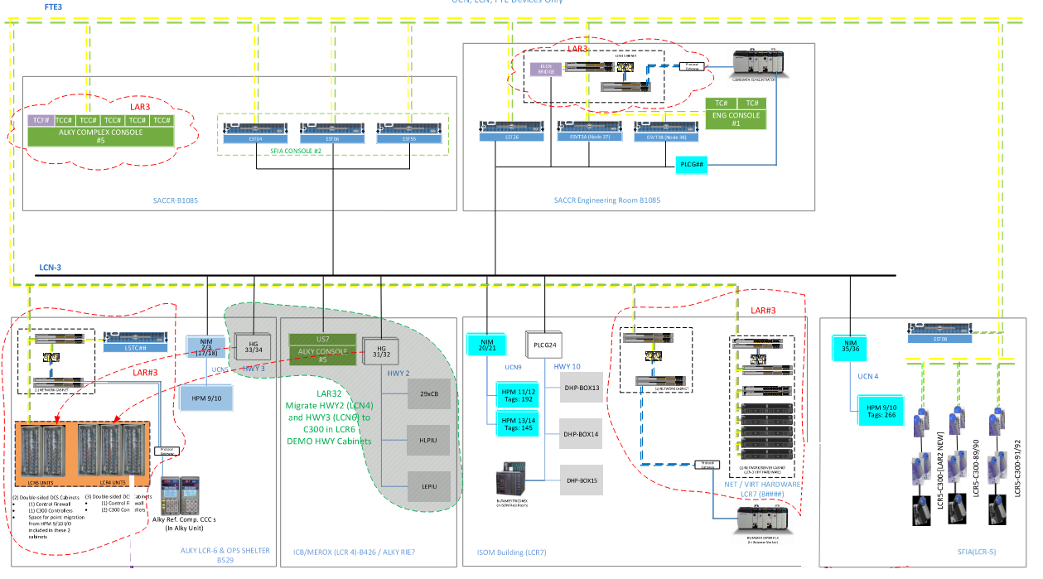
LAR3 AMP - Scope
Area 5, Alky BPCS Migration

Slide 18
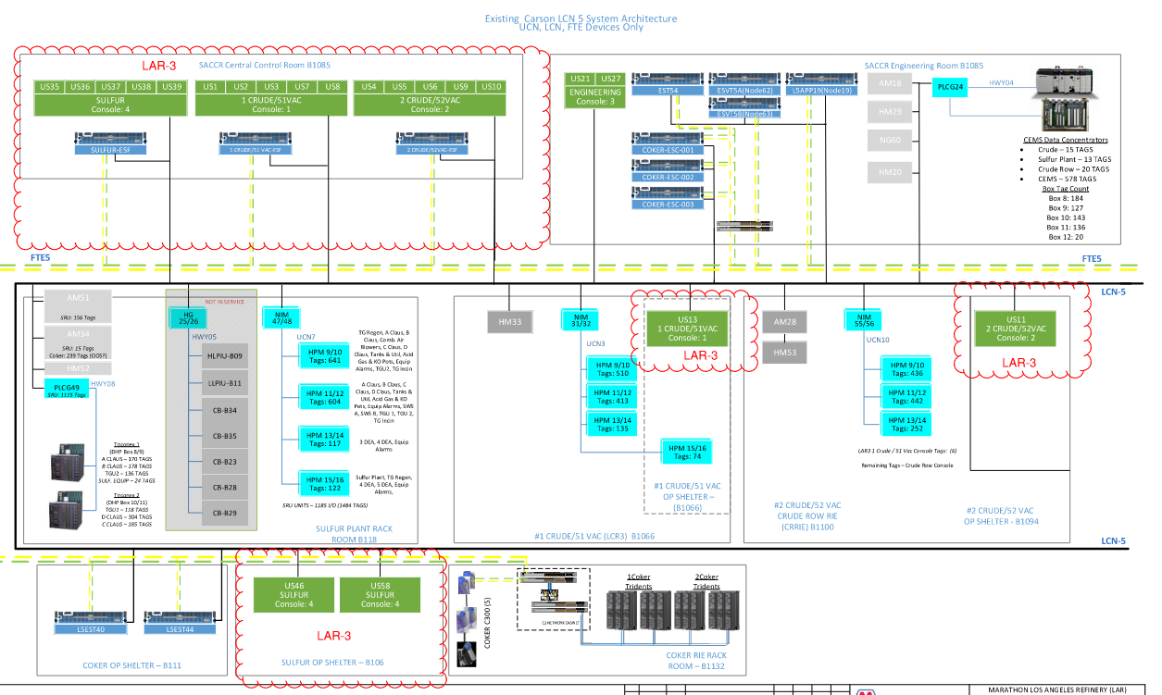
LAR3 AMP - Scope
Area 5, Alky BPCS Migration

Slide 19
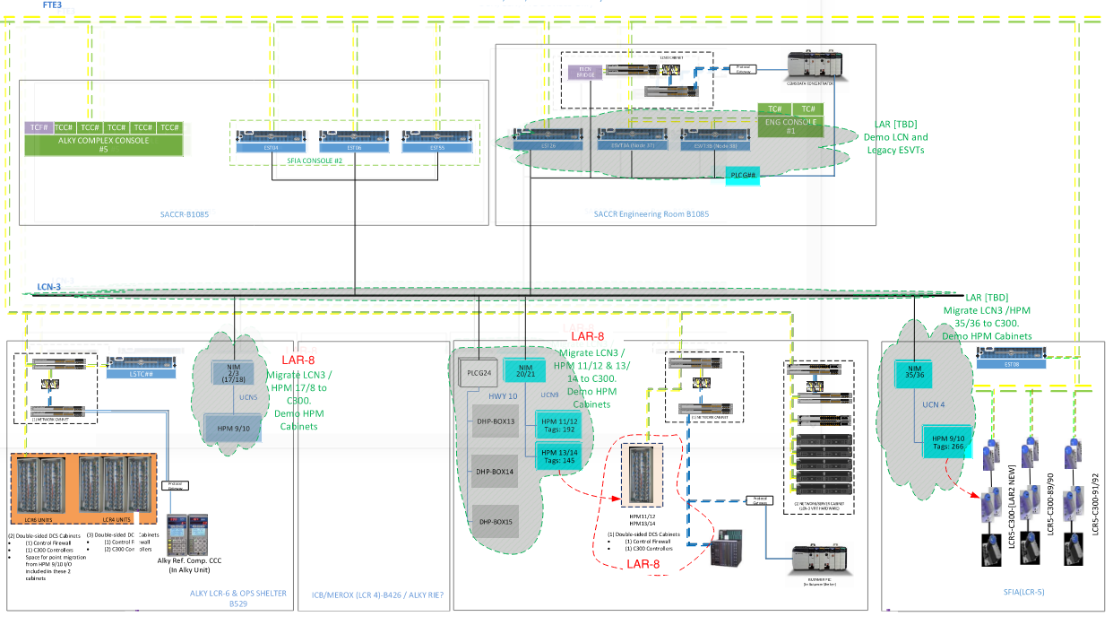
LAR3 AMP - Scope
Area 5, Alky BPCS Migration

Slide 20
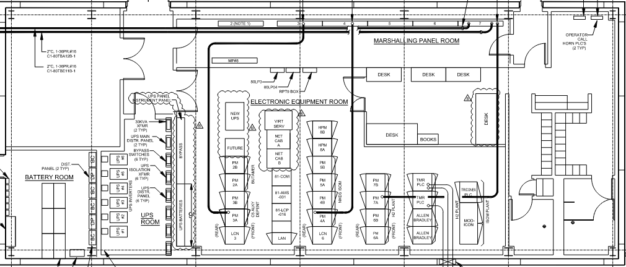
LAR3 AMP - Scope
LAR-C South Area Network Virtualization (Temp) – LCR-7 ISOM Ops Shelter

Slide 21
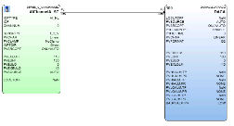
LAR3 AMP - Scope
Area 1, LAR-C ALKY BPCS – DCS Controller Upgrades
RED = New
BLACK = Existing
As Found
The units within the ALKY console consist of both Hiway (Basic Controllers, HLPIU, etc.), HPM controllers, and PLCGs.
Hiway 2 is located in the LCR-4 control room. This building has been determined unsuitable for new control systems.
Hiway 3 is currently located in LCR-6 control room. This building is suitable for the installation of new control systems.
Per current LAR AMP project objectives, HPM’s will be addressed in the LAR-8 AMP project.
New Scope
Migration of Alky Hiway 2 and Hiway 3 loops to (4) new C-300s, all located in LCR-6.
Majority of loops will be “hot cutover”, with up to 25% “cold cutover” in the October ‘25 TAR
Pre-TAR cutover sequencing will be as follows:
Migrate Alky Console to Experion
Hot cutover of LCR-6 loops, followed by demo of LCR-6 Hiway cabinets
Installation of balance of C-300s in LCR-6
Hot cutover of LCR-4 loops
There are 2 control loops currently wired to the control system in the SFIA unit that are operated from the ALKY console. These will be re-wired directly to the C-300s in LCR-6

Slide 22
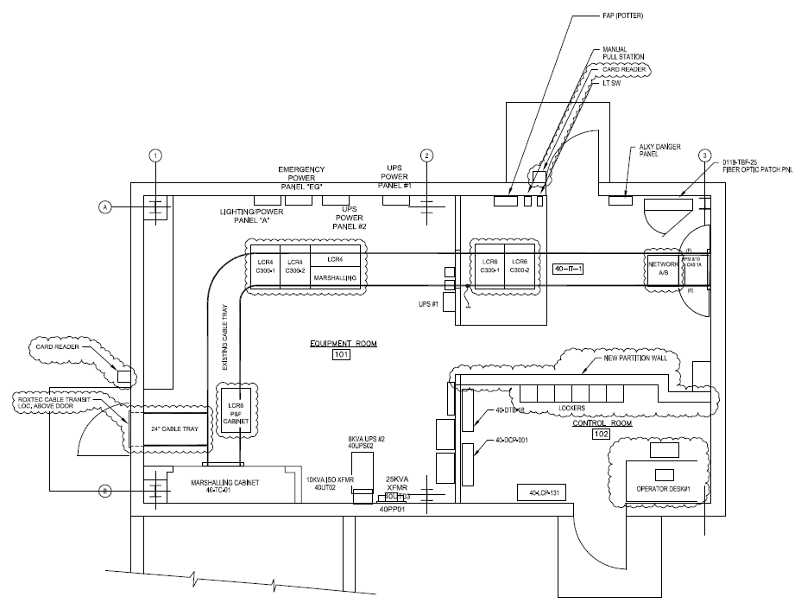
LAR3 AMP - Scope
Area 1, LAR-C ALKY BPCS – LCR-6 Installations
RED = New
BLACK = Existing
As Found
US Station based Operator Console
Hiway 2 BPCS Hardware and associated marshalling panels
HPM – will be migrated in LAR-8
New Scope
Install new Network Cabinet to support the new Experion C-300s and Experion Console
Install new C-300s and marshalling panels
Install new Operator Console furniture
New partition wall to create separation between the local Operator Console and the Experion BPCS network and controller hardware
Install new card key building access controls
New Roxtec cable transit for new home-run cables coming from LCR-4 area junction boxes
New cable tray along East/West piperack to support home-run cables

Slide 23
LAR3 AMP - Scope
Area 5, LAR-C SACCR– Console & Network Virtualization
RED = New
BLACK = Existing
As Found
SFIA/Wastewater Consoles - AMP LAR2 will be upgrading the SFIA and Wastewater console furniture and virtualizing the associated console station PCs and hardware.
ALKY, ISOM, Crude 1, Crude 2, SRU Consoles consist of a mix of US stations, Flex Stations, and hardwired pushbutton panels
New Scope
Existing Universal Station based consoles in Carson SACCR will be replaced with modern furniture and electronics supported by a new virtualization host server and network.
New console group for each unit with one corporate business section; one quad screen physical station; two dual screen virtual stations; two each 55” upper mounted screens with choice of PI or other input; one directional speaker for radio, alarming, and music/news.
ISOM/ALKY New Turret section containing push buttons will be incorporated between the ISOM/ALKY console groups.

Slide 24
LAR3 AMP - Scope
Local Control Rooms Console Migration
RED = New
BLACK = Existing
As Found
ISOM, Crude 1, Crude 2, SRU Local Operator Shelters consist of US stations
Coker
SRU
New Scope
ISOM, Crude 1, Crude 2, SRU new Desks with virtual view only dual screen thin client in each local control room (LCR4 Alky is demo only, to be consolidated with LCR6)
SFIA
CRUDE

Slide 25
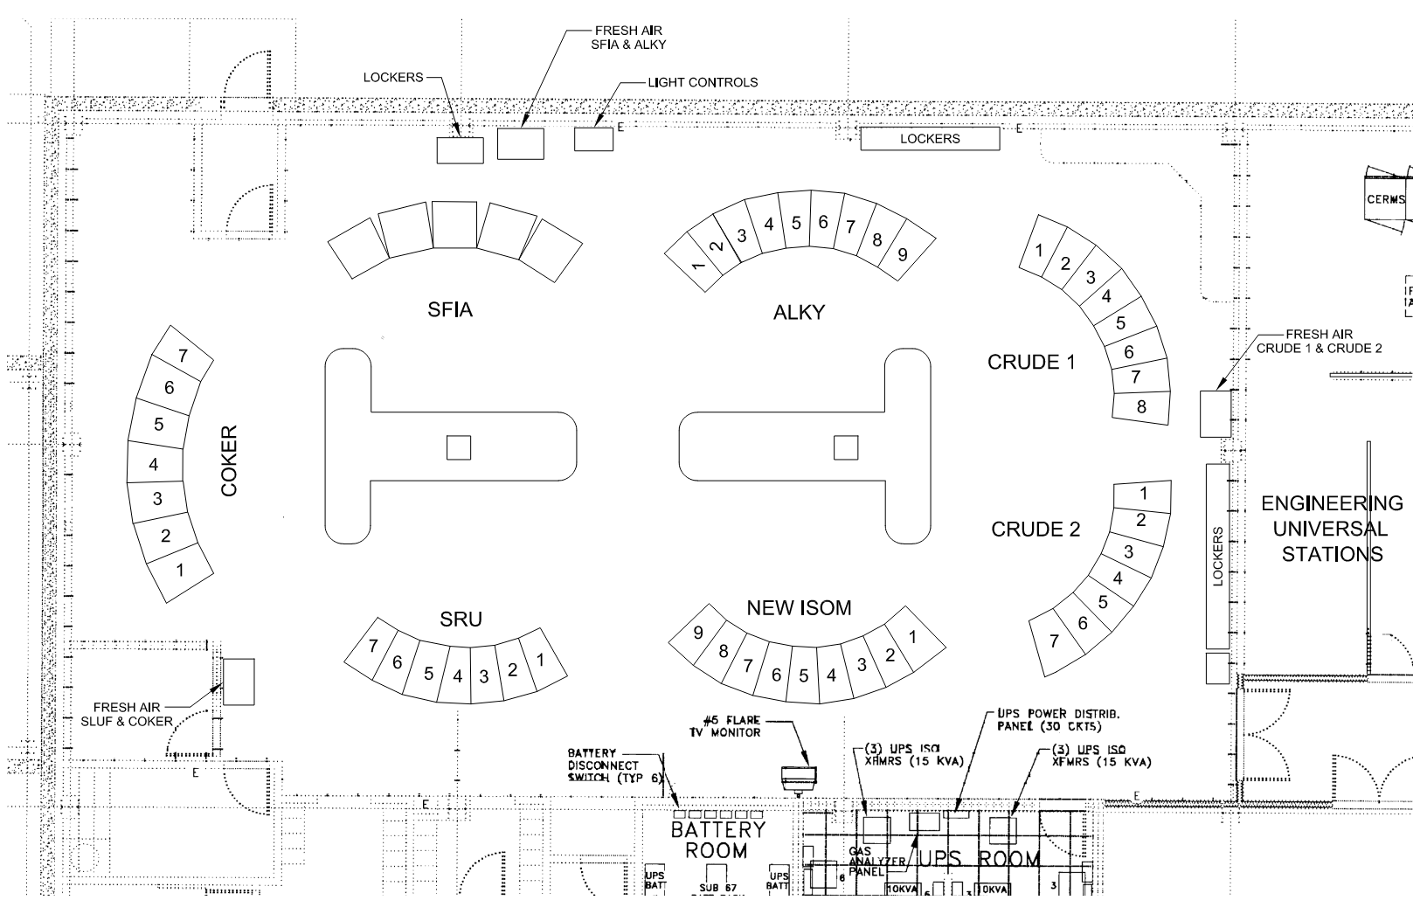
LAR3 AMP - Scope
Area 3, 1 Crude / 51 Vac Console Migration; Area 5, ISOM / Alky Console Migration; Area 9 SRU Console Migration
Coker
SRU
SFIA
CRUDE
Existing Layout

Slide 26
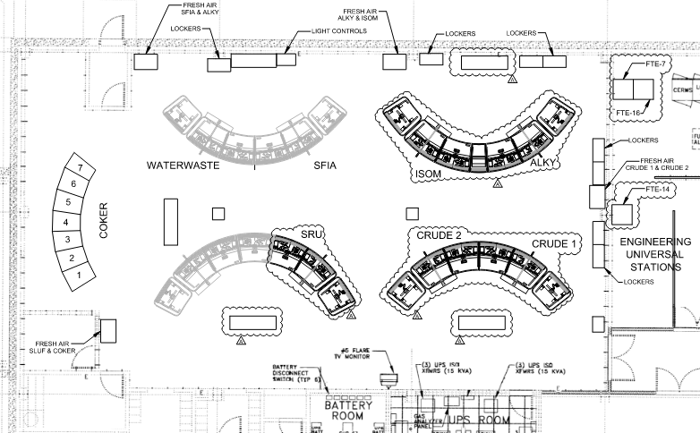
LAR3 AMP - Scope
Area 3, 1 Crude / 51 Vac Console Migration; Area 5, ISOM / Alky Console Migration; Area 9 SRU Console Migration
Coker
SRU
SFIA
CRUDE
New Layout
Alky / ISOM

Slide 27
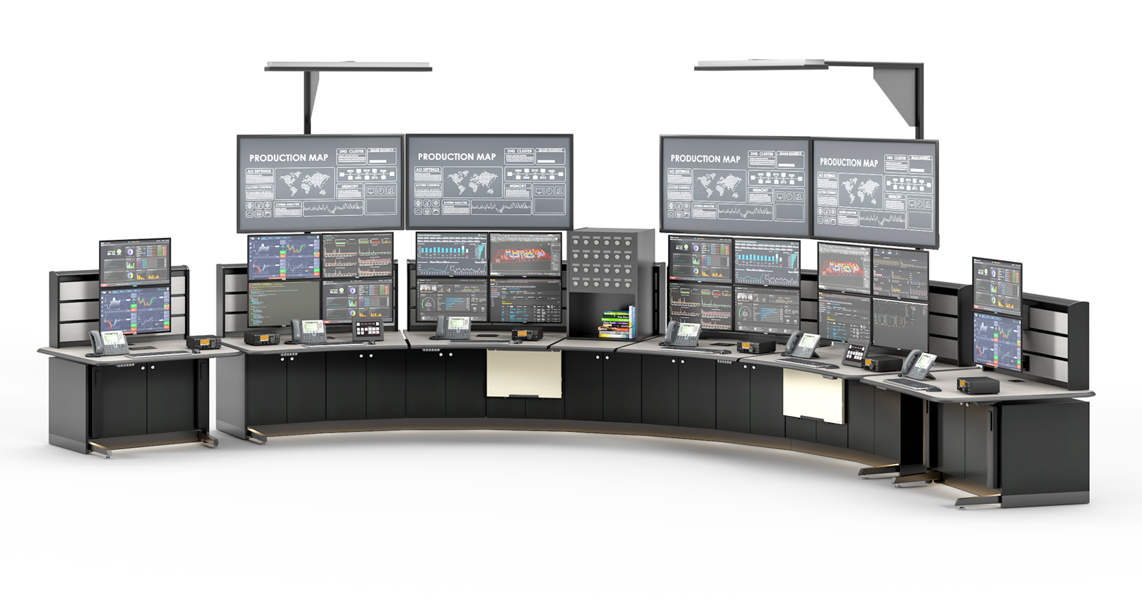
Typical Console Rendering
LAR3 AMP - Scope

Slide 28

LAR3 AMP - Scope
Area 2, LAR-C FCC Unit – PLCs
RED = New
BLACK = Existing
GP PLC = General Purpose (& Proprietary Devices)
SPLC = Safety PLC (e.g. Triconex)
PLC Equipment
Pignone 1st Stage Compressor
As Found
AB SLC 5/03, No Comms
New Scope
Pignone 1st Stage Compressor – Full PLC upgrade to AB ControlLogix to address obsolescence. New Modbus TCP connection to the new Experion server will be installed. New connection will provide ability to display compressor data on the new HMIWeb graphics.

Slide 29
LAR3 AMP - Scope
Area 3, LAR-C #1Crude/51 VAC – PLCs
RED = New
BLACK = Existing
GP PLC = General Purpose (& Proprietary Devices)
SPLC = Safety PLC (e.g. Triconex)
PLC Equipment
3South Area CEMS Data Concentrator (PLC5)
South Area CEMS Data Concentrator (CLX)
1CRUDE Unit Alarm PLC
As Found
AB PLC-5, AB RS-232 to LCN
AB ControlLogix, Modbus RTU to LCN
MicroLogix 1000, No Comms
New Scope
South Area CEMS Data Concentrator (PLC5) – Install new protocol converter which will provide simultaneous Modbus connection to the existing LCN and the new Experion server. Dual connection will mitigate data interruption while cutting over points from TDC to Experion.
South Area CEMS Data Concentrator (CLX) - Install new protocol converter which will provide simultaneous Modbus connection to the existing LCN and the new Experion server. Dual connection will mitigate data interruption while cutting over points from TDC to Experion.
1CRUDE Unit Alarm PLC - PLC hardware will be upgraded from MicroLogix 1000 to MicroLogix 1400 to address obsolescence. No DCS comms will be added.

Slide 30
LAR3 AMP - Scope
Area 5, LAR-C ALKY – PLCs
RED = New
BLACK = Existing
GP PLC = General Purpose (& Proprietary Devices)
SPLC = Safety PLC (e.g. Triconex)
PLC Equipment
Merox Unit Alarm PLC
Butamer Dryer PLC
Alky Refrigeration Comp. CCC
Isom/Butamer SPLC
As Found
AB MicroLogix 1000, No Comms
AB CLX, Modbus RTU to LCN
CCC Series 3++, Modbus RTU to LCN
Triconex, Modbus RTU to LCN
New Scope
Merox Unit Alarm PLC – Existing PLC will be demolished and alarm panel I/O will be wired to new Alky C300. PLC logic will be migrated to new ALKY C300.
Butamer Dryer PLC – PLC processor will be upgraded to latest model. Modbus communications to DCS will be converted from Modbus RTU to Modbus TCP and connected to the new Experion network. Run new fiber to support new Modbus TCP connection.
Alky Refr. Comp CCC – Modbus communications to DCS (via PLCG) will be converted from Modbus RTU to Modbus TCP and connected to the new Experion network in LCR-6.
Isom/Butamer SPLC – No scope. Modbus migration to Experion will take place when the Butamer HPMs are migrated to C300.

Slide 31
LAR3 AMP - Scope
Area 9, LAR-C Sulfur Unit – PLCs
RED = New
BLACK = Existing
GP PLC = General Purpose (& Proprietary Devices)
SPLC = Safety PLC (e.g. Triconex)
PLC Equipment
SRU Unit Alarm PLC
SRU Loading Rack PLC
SRU TMR SYS1
SRU TMR SYS2
As Found
AB MicroLogix 1000, No Comms
AB SLC-5/03, No Comms
Triconex, Modbus RTU to LCN
Triconex, Modbus RTU to LCN
New Scope
SRU Unit Alarm PLC - PLC hardware will be upgraded from MicroLogix 1000 to MicroLogix 1400 to address obsolescence. No DCS comms will be added.
SRU Loading Rack PLC - Full PLC upgrade to AB ControlLogix to address obsolescence. No DCS comms will be added.
SRU TMR SYS1 - No scope. Modbus migration to Experion will take place when the SRU HPMs are migrated to C300.
SRU TMR SYS2 - No scope. Modbus migration to Experion will take place when the SRU HPMs are migrated to C300.

Slide 32
CARSON FIBER
CONFIDENTIAL
32

Slide 33
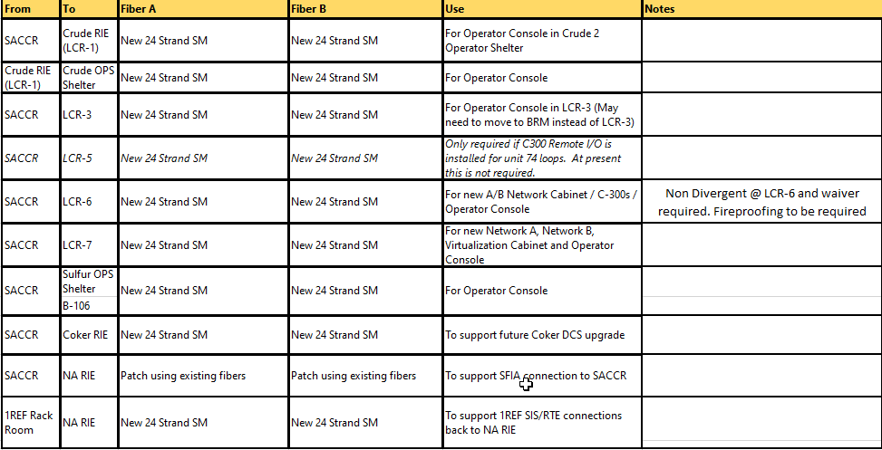
LAR3 AMP - Scope
Carson, Fiber
As Found
Existing blown fiber infrastructure (tube bundles and blown fiber) installed by LAR-1/LARB
New Scope
Install new conduit, tube bundles, patch panels, and blown fiber as indicated below
Blowing new fibers into existing fiber infrastructure (conduit and tube bundles) where possible.

Slide 34
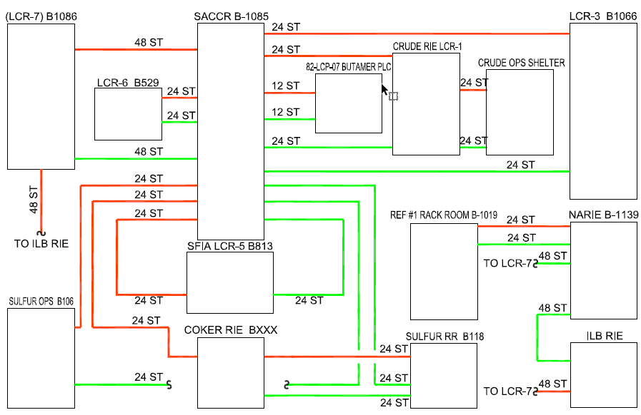
LAR3 AMP - Scope
Carson, Fiber

Slide 35
CARSON-TO-WILMINGTON FIBER
CONFIDENTIAL
35

Slide 36
LAR3 AMP - Scope
Carson-to-Wilmington Fiber
As Found
Site-to-site fiber installed by LASR project – routed via new power poles
LARIC tunnel – can be used to route new fiber between Carson and Wilmington
New Scope
Install new Site-to-Site fiber infrastructure to support future separation of A and B networks geographically into Carson and Wilmington
LARIC tunnel will be “primary –A” network
LASR will be “secondary – B” network

Slide 37
WILMINGTON SLIDES
CONFIDENTIAL
37

Slide 38
LAR3 AMP - Scope
Area 7, WHCU Heater LOPA & RSP Gap
RED = New
BLACK = Existing
Equipment
Reactor #1 H₂ Heater (H-300)
Reactor #2 H₂ Heater (H-301)
Reactor #3 H₂ Heater (H-302)
2nd Stage Charge Heater (H-303)
Fractionator Reboiler Heater (H-304)
As Found
All heaters have trips in existing unit SPLC
(HW Safety Manager)
New Scope
Applies to all heaters (H-300/301/302/303/304)
2 new fuel gas chopper valves with bypass and ASCO RCS. Demo existing chopper valve.
2 new pilot gas chopper valves
1 new SIS fuel gas pressure XMTR, downstream of existing FG control valve
1 new SIS pilot gas pressure XMTR downstream of existing regulator
2 new manual ESDs – remote (>50ft from heater), local (LOP)
Add interlock for O₂ analyzer probe heater power de-energization on full heater trip
Add flame scanners (H-300 (6), H-301 (3), H-302 (6), H-303 (4), H-304 (3+3)
Applies per SCR system (H-300/301, H-302/303, H-304)
1 new light-off panel (LOP)
1 new relay for SCR ammonia control valve trip on loss of ID fan or fuel gas trip
Add additional cabinet and 2 chassis with I/O modules to existing HW Safety Manager 05-IPS-01 in HPD rack room

Slide 39
LAR3 AMP - Scope
Area 7, WHCU Compressor LOPA & RSP Gap
RED = New
BLACK = Existing
Equipment
HCU Recycle Gas Compressor (C-93)
As Found
Surge control exists in C-300.
No existing surge shutdown.
New Scope
Add surge shutdown from existing C300 control logic to existing Safety Manager shutdown logic.

Slide 40
LAR3 AMP - Scope
Area 7, HGU-2 Heater LOPA & RSP Gap
RED = New
BLACK = Existing
Equipment
Steam-Methane Reformer (H-42)
As Found
Trips and permissives in existing relay logic
New Scope
Applies to reformer heater H-42
2 new fuel gas chopper valves with bypass and ASCO RCS. Demo existing chopper and vent.
Add bypass around purge gas chopper valves. Demo solenoids and add ASCO RCS.
2 new pilot gas chopper valves. Demo existing chopper and vent.
Replace fuel gas and purge gas pressure switches with pressure XMTRs (1 BPCS, 2 SIS)
Demo pilot gas pressure switches. Migrate pilot gas pressure XMTR to new SIS.
Add interlock for O₂ analyzer probe heater power de-energization on full heater trip
1 new relay for SCR ammonia CV trip on loss of ID fan or unit fuel gas trip (H-42 & H-43)
9 new flame scanners
1 new light-off panel (LOP)
1 new manual ESD – remote (>50ft from heater). Migrate existing ESDs to new SIS.
Reconfigure steam drum GWR level XMTRs for 2oo2 voting on low level
1 new steam drum pressure XMTR. Migrate existing XMTR to SIS for 2oo2 high press. trip
Existing relay logic in Sub #9 will be demo’d. 1 new Tricon CX SIS for H-42 will be installed in HPD Rack Room. Existing logic will be migrated to new SIS.

Slide 41
LAR3 AMP - Scope
Area 7, HGU-2 Boiler LOPA & RSP Gap
Equipment
Auxiliary Boiler (H-43)
Trim Burners
As Found
Trips and permissives in existing relay logic
New Scope
Applies to Aux Boiler H-43
2 new fuel gas chopper valves with bypass and ASCO RCS. Demo existing chopper and vent.
Add limit switches to existing pilot gas chopper and vent valve
Demo fuel gas pressure switches. Add 1 new SIS fuel gas pressure XMTR.
Demo pilot gas pressure switches. Migrate pilot gas pressure XMTR to new SIS.
Replace instrument air and FD fan duct low pressure switches with pressure XMTRs
Add speed transducer on FD fan shaft
1 new SIS flow XMTR on FD fan inlet air flow
Demo existing steam drum level switches and replace with 2oo2 GWR level XMTRs
1 new steam drum pressure XMTR. Migrate existing XMTR to SIS for 2oo2 high press. trip
2 new windbox O₂ analyzers
1 new firebox pressure XMTR
Replace existing obsolete flame scanners
Replace existing 120VAC boiler control panel with new light-off panel (LOP)
1 new manual ESD – remote (>50ft from boiler). Migrate existing ESDs to new SIS.
Existing relay logic in Sub #9 will be demo’d. 1 new Tricon CX SIS for H-43 and trim burners will be installed in HPD Rack Room. Existing logic will be migrated to new SIS and updated per RSP requirements.

Slide 42
LAR3 AMP - Scope
Area 7, HGU-2 Boiler LOPA & RSP Gap
Equipment
Auxiliary Boiler (H-43)
Trim Burners
As Found
Trips and permissives in existing relay logic
New Scope
Applies to the Trim Burners
Demo fuel gas chopper valve solenoid and replace with ASCO RCS
Add limit switches on all existing fuel gas & pilot gas chopper valves
Demo fuel gas pressure switches. Add 1 new SIS fuel gas pressure XMTR.
Demo pilot gas pressure switches. Add 1 new SIS pilot gas pressure XMTR.
Replace existing obsolete flame scanners
Replace existing 120VAC trim burner ignition panel with new light-off panel (LOP)
3 new manual ESDs – console, remote (>50ft from boiler), local (LOP)

Slide 43
LAR3 AMP - Scope
Area 7, HGU 2 Compressor LOPA & RSP Gap
RED = New
BLACK = Existing
Equipment
HGU2 Hydrogen Compressor (C-84)
HGU2 Feed Gas Compressor "A" (C-146)
HGU2 Feed Gas Compressor "B" (C-147)
HGU2 H2 Product Compressor (C-148)
As Found
No existing vibration shutdown
New Scope
Applies to all compressors (C-84, C-146, C-147, C-148)
1 new Bently Nevada 1900 Vibration Monitor per compressor
New shutdowns will utilize existing spare I/O in Safety Manager 06-IPS-01
New analog input module will be added to existing SPLC rack to replenish spare I/O capacity

Slide 44
LAR3 AMP - Scope
NACR Virtualization Cabinet
RED = New
BLACK = Existing
New Scope
Install new Virtualization Cabinet in NACR to support future AMP LAR Phases

